Slide 2
How I built a live quiz app for ~100K players on Azure
@MithunShanbhag

Slide 3

Mithun Shanbhag
Consulting:
Azure, .NET, Angular
CTO, Architect, Developer Services
Building micro-SaaS:
cloudskew.com
quiz.konfhub.com
and more…..
Ex Microsoft
Windows Server, CLR, Visual Studio, Azure
Twitter: @MithunShanbhag

Slide 4


Slide 6
Spiky Loads?

Slide 7
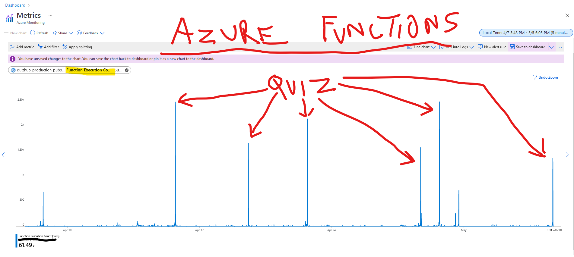

Slide 8
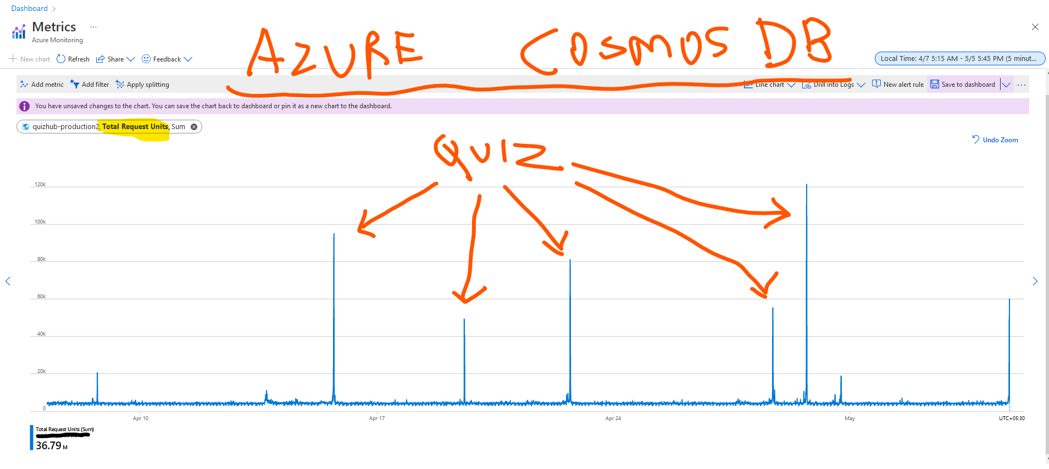

Slide 9
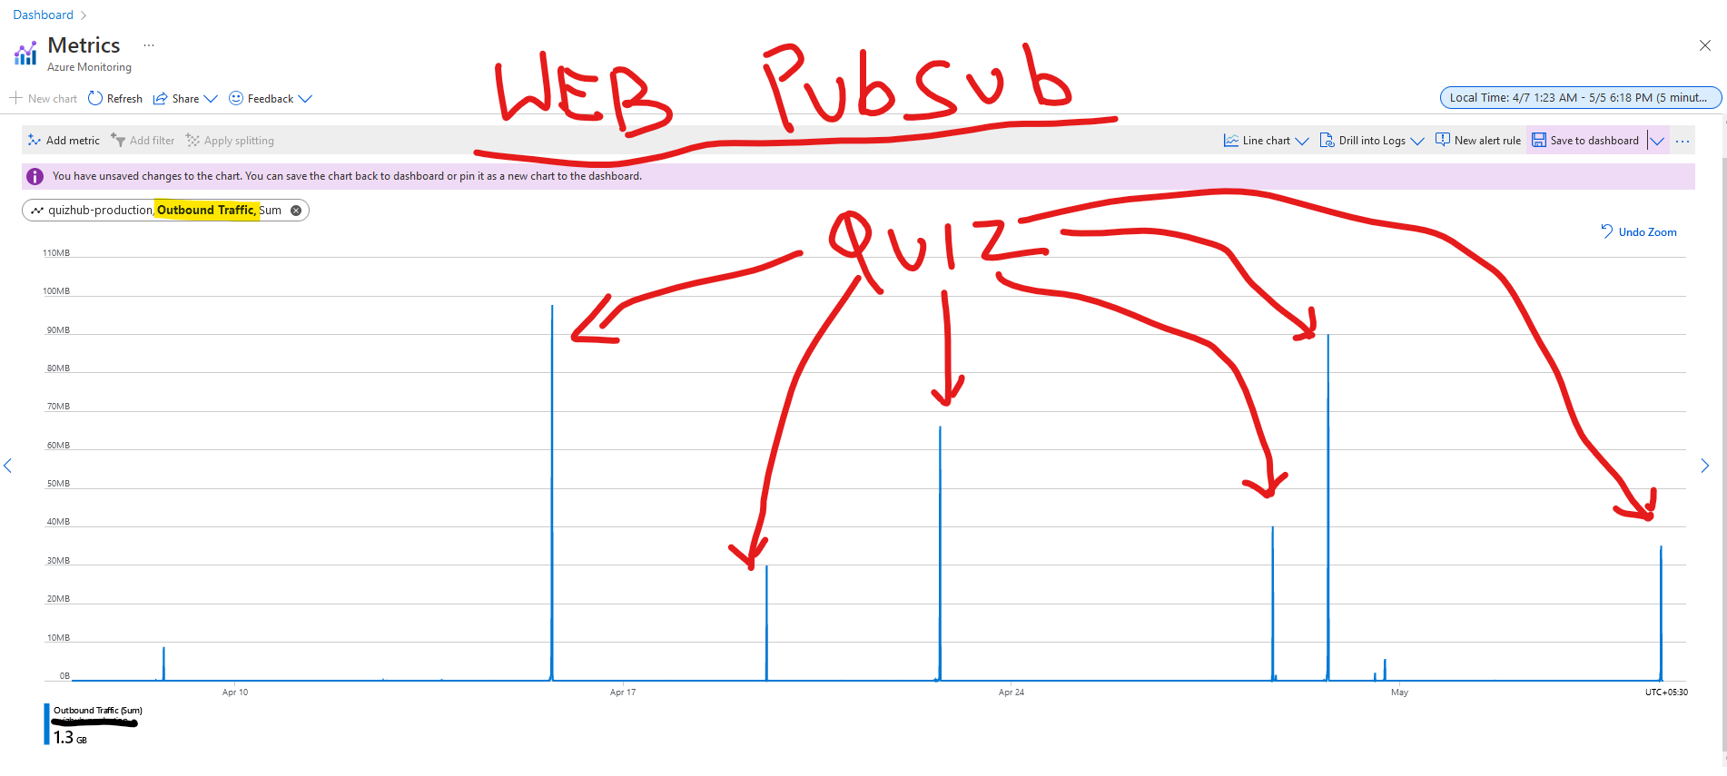

Slide 10
Guiding Principles?

Slide 11

Microservices patterns
12 factor app
Limits/quotas for Azure resources

Slide 12
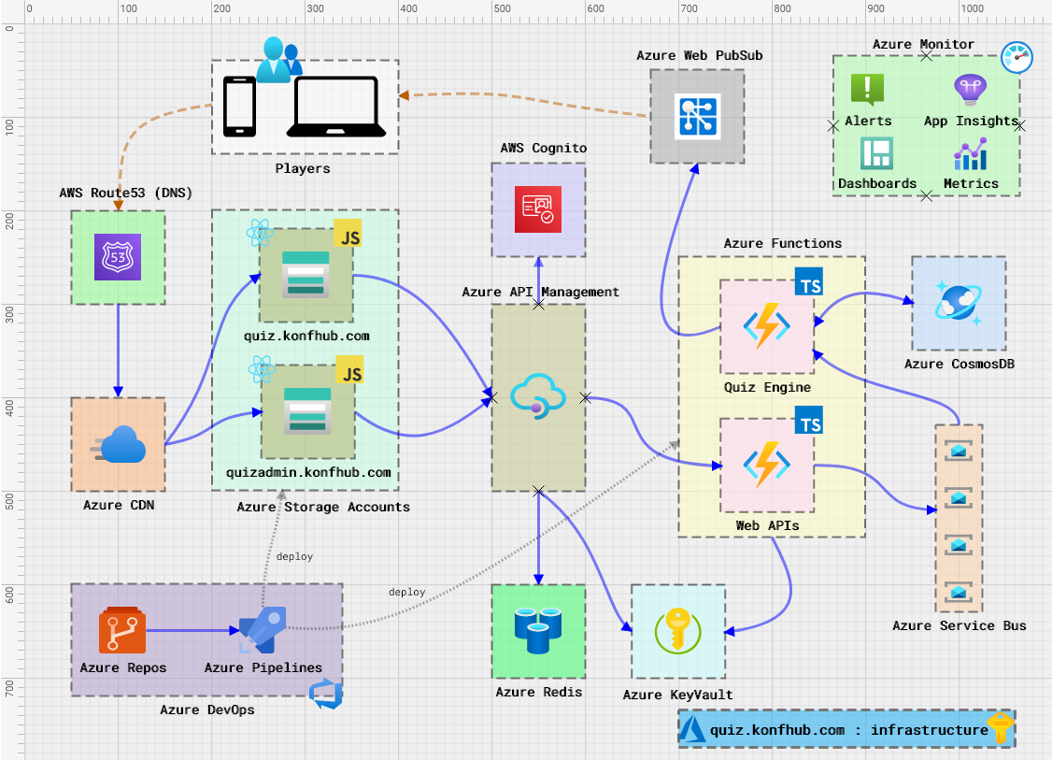

Slide 13
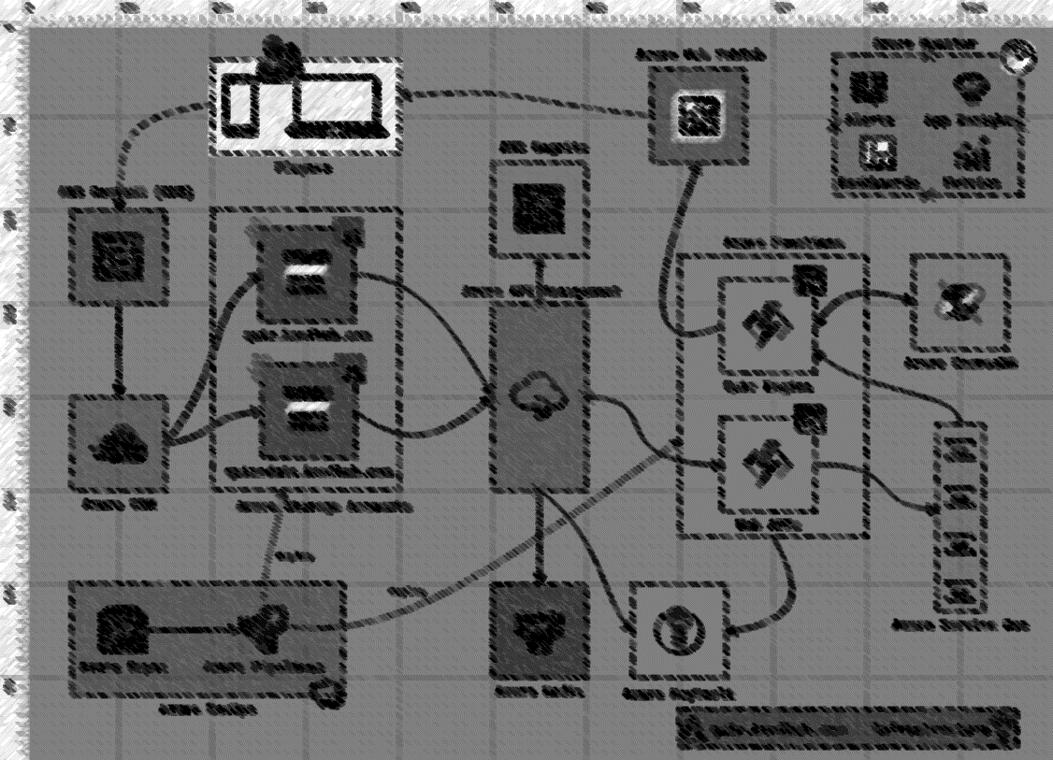

Slide 14
Notes:
- CNAME records

Slide 15
Notes:
Caching (at regional POPs)
Compression
Rewriting rules
Managed TLS certs

Slide 16
Notes:
- Static site hosting

Slide 17
Notes:
- Policies: JWT validation, CORS, caching, rate limiting

Slide 18
Notes:
Centralized configuration
Self bootstrapping

Slide 19
Notes:
- Access token validated against Open ID endpoint

Slide 20
Notes:
For data that is either expensive to fetch or changes infrequently

Slide 21
Notes:
- Consumption plan

Slide 22
Notes:
Queue based load leveling
Event stores (

Slide 23
Notes:
- Queue processor,

Slide 24
Notes:
Data encrypted over the wire (TLS 1.2)
Data encrypted at REST (Microsoft managed keys)
Serverless tier, SQL CORE APIs (JSON docs)

Slide 25
Notes:
- CosmosDB triggered, Service bus triggered

Slide 26
Notes:
- Push questions, evaluations, leaderboards, points/positions etc to users (AES encrypted)

Slide 29
Notes:
- Azure DevOps tasks (deploy to function apps) or AZ CLI (deploy to storage, purge CDN)

Slide 31
Scaling Challenges?

Slide 33


Slide 35
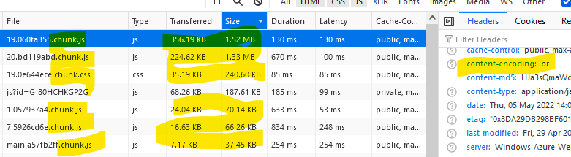
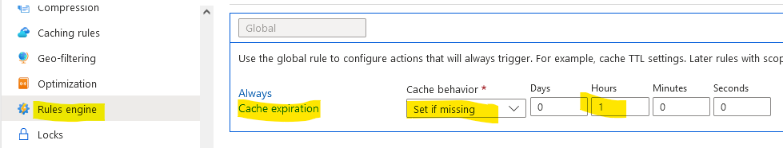
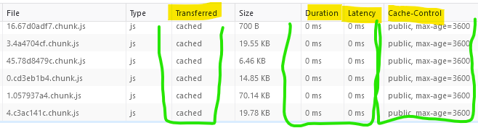
Compression enabled only when file size < 8 MB. So, use lazy-loaded modules, chunked files.
Don’t forget to set CACHE-CONTROL header to enable browser caching (for F5/refreshes).

Slide 37
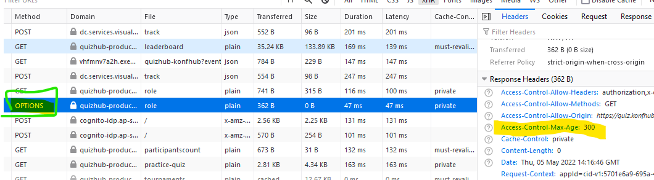
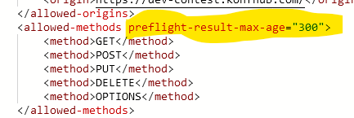
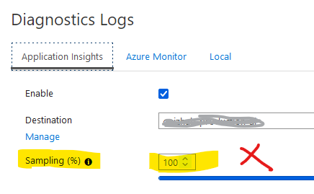
Don’t forget to cache preflight requests via CORS policy.
In high traffic scenarios, never set sampling rate to 100% for diagnostic logging.

Slide 40
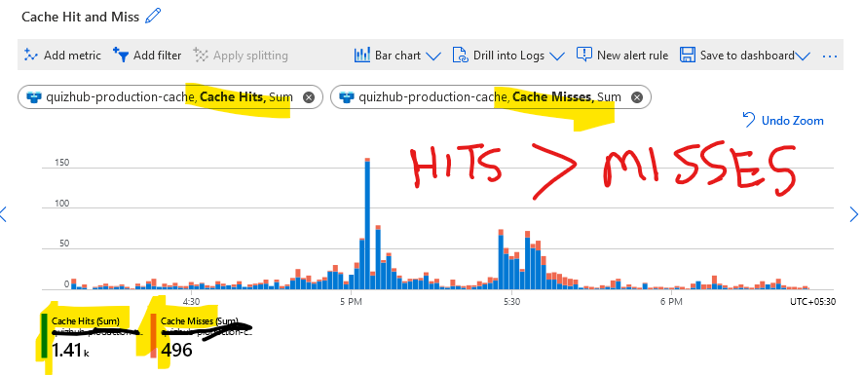
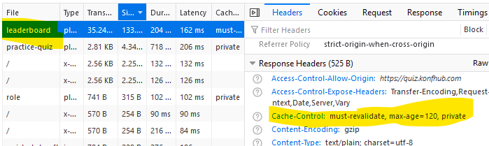
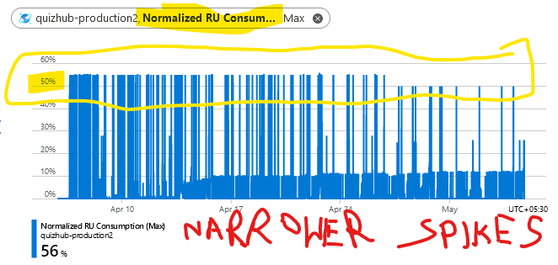
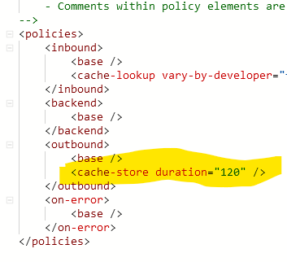
Cache your most expensive API calls (if possible).

Slide 41
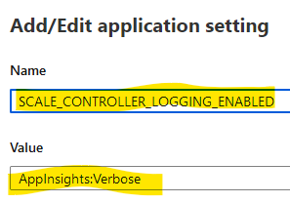
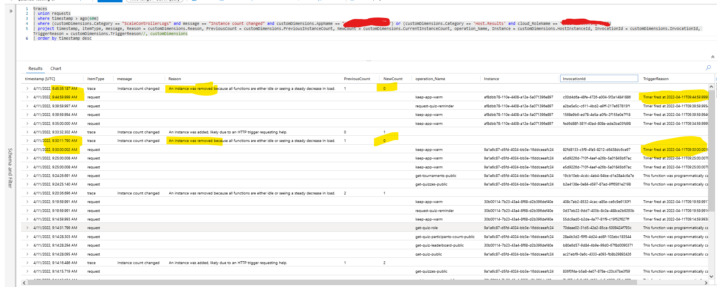
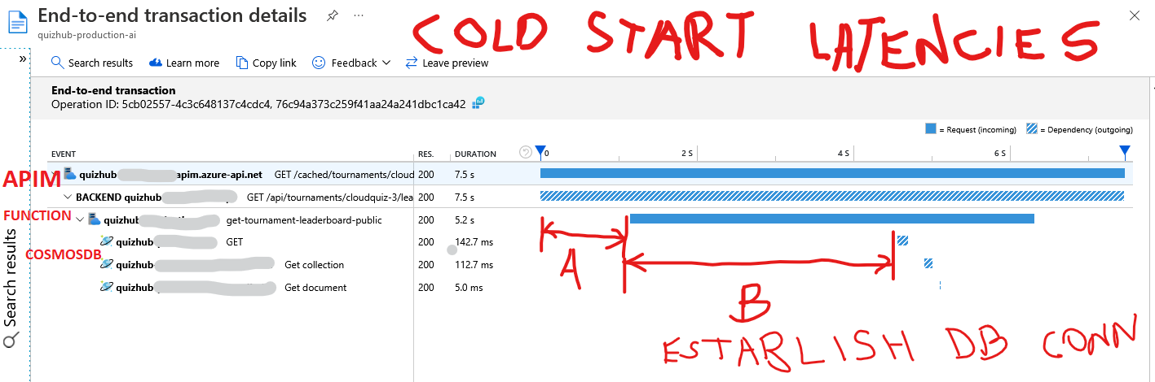
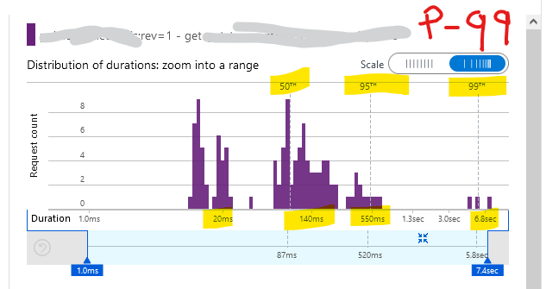
Flavors of scaling:
Event driven (consumption, premium plans)
Manual / Rule based (dedicated app service plan)
Unit of scaling are apps, not functions.*
Service bus triggered functions are exceptions.
Functions that can’t scale together shouldn’t be in the same app.
Enable scale controller logs
Timer trigger hack doesn’t work anymore, use premium/dedicated for pre-warmed instance.
Every new scaled out instance will incur cold start (unless warmup trigger used).

Slide 42
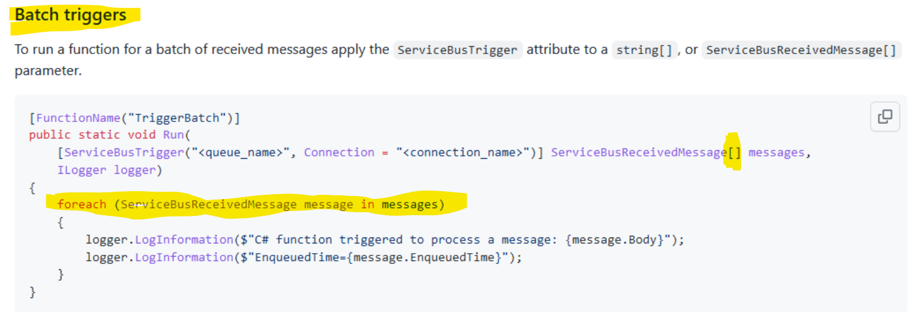
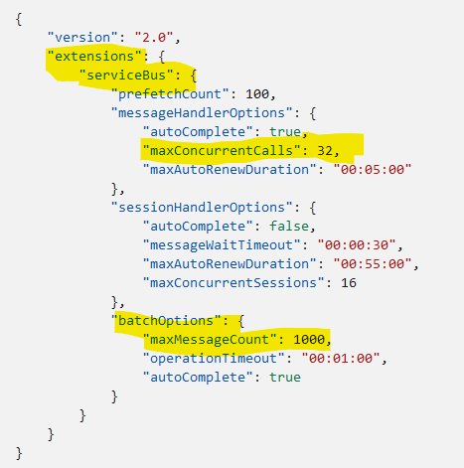
Use batch triggers for Service Bus listeners.
Combine batch triggers with unit-of-work patterns / transactional commits.
Tweak host.json settings.

Slide 43
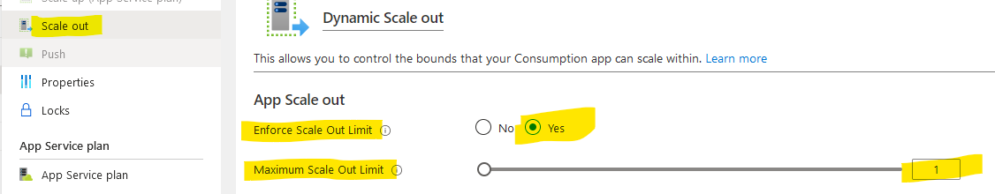
Suppress/limit scale-outs if necessary.

Slide 44
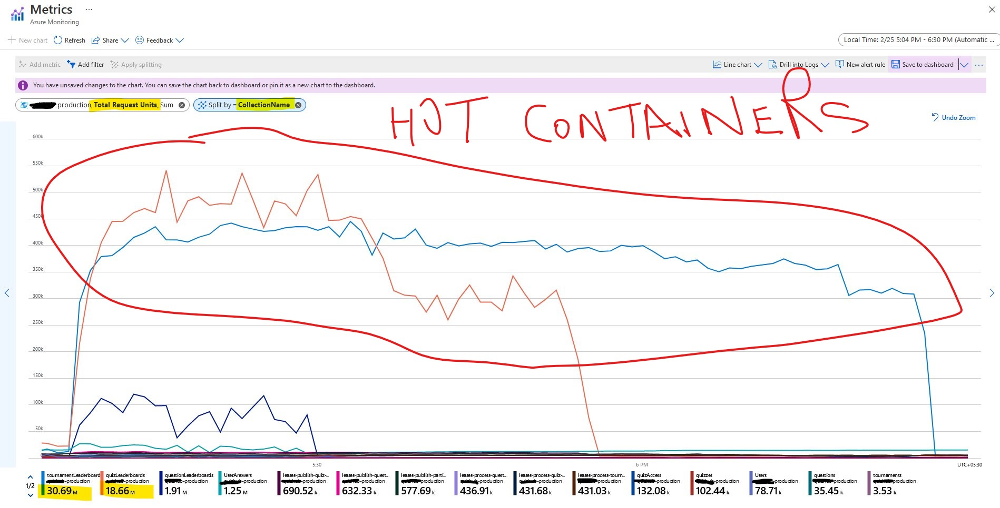
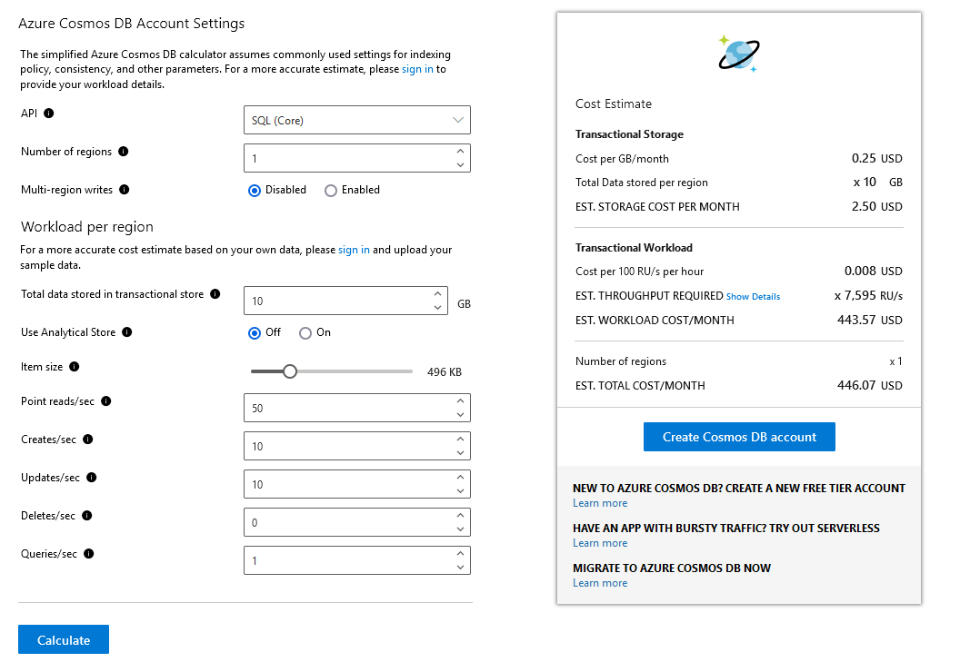
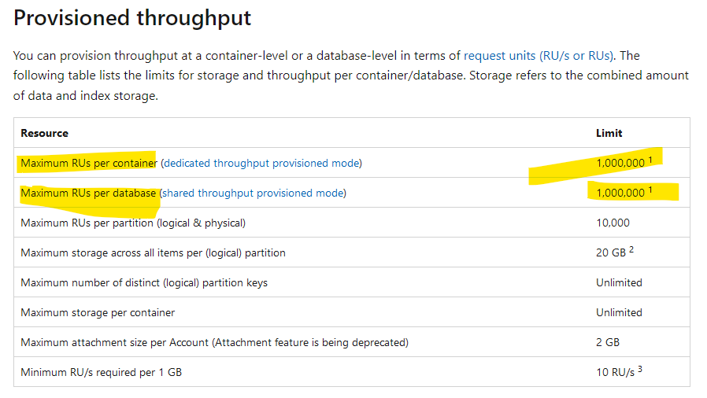
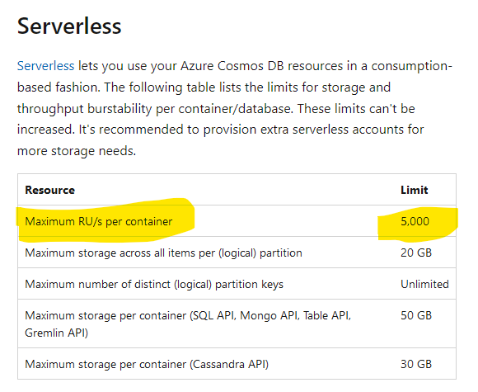
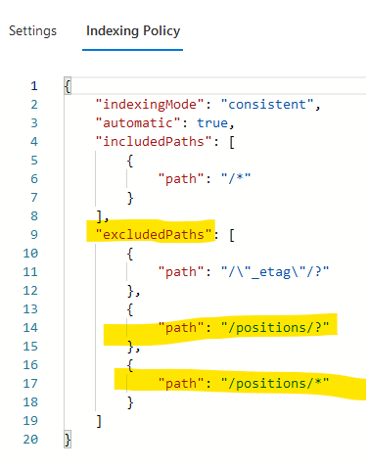
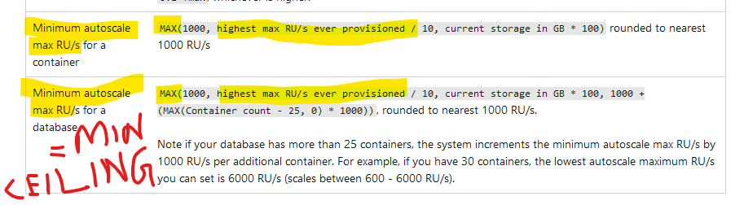
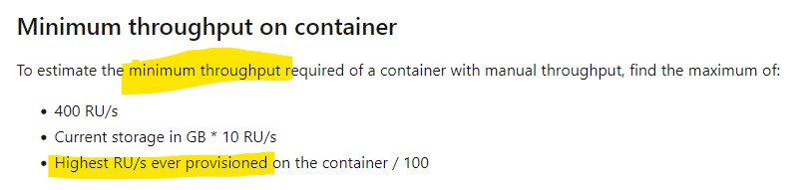
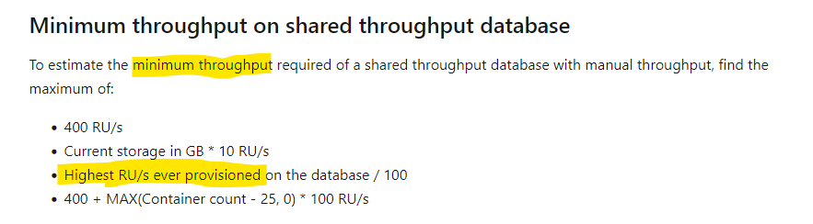
Always start with the Cosmos DB capacity calculator.
Beware of “hot” containers
Prefer dedicated container throughput over shared db throughput.
Beware of arbitrarily raising the throughput too high!
You may not be able to scale down to previous floor.
Serverless tier is awesome for spiky workloads, but has limitations.
Caps at container, partition level.
No regional replicas.
For large documents, drop unnecessary properties from index.

Slide 45
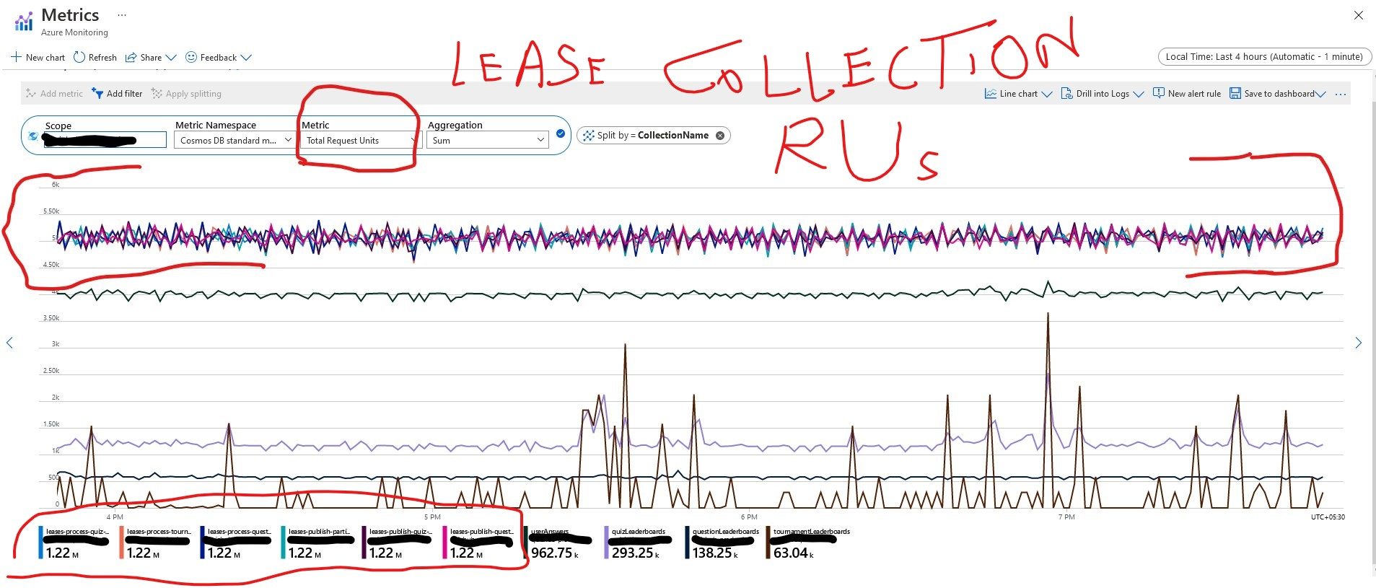
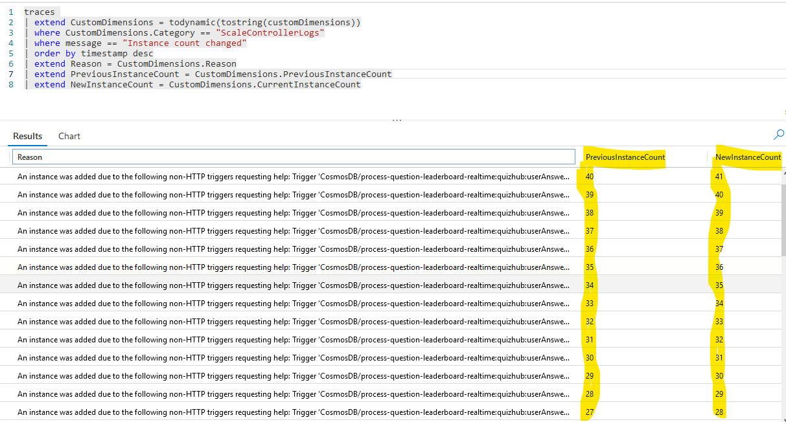
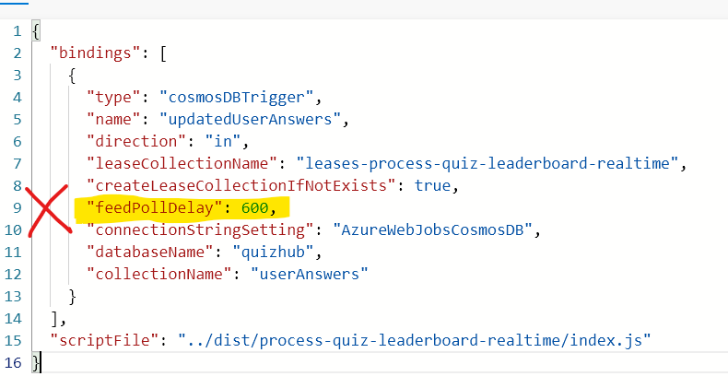
Materialized views in CosmosDB need change feed processors / triggers.
CosmosDB triggers will increase RU consumption.
Mitigation: Increase ‘feedPollDelay’ (5 secs default).
CosmosDB triggers will add scale-out pressure.
Mitigation: Limit scale-out instances.
Use CosmosDB input bindings only for scalar / point reads.
Use SDK for inter/intra partition scans, full-table scans.

Slide 46
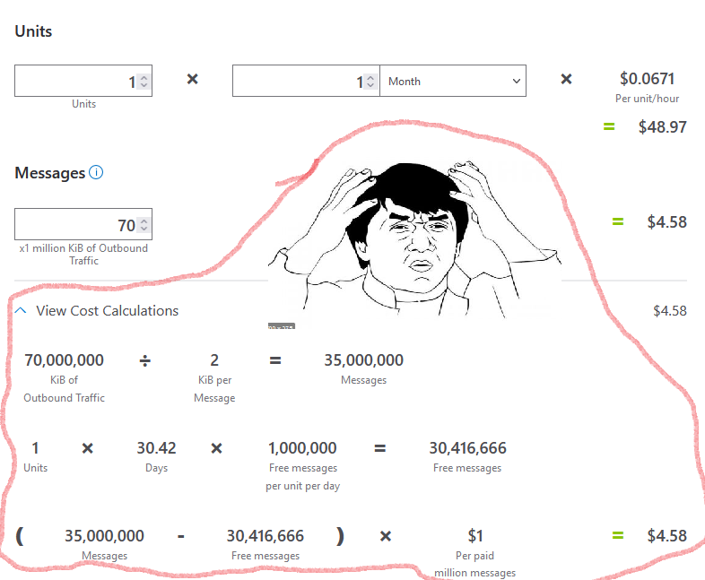

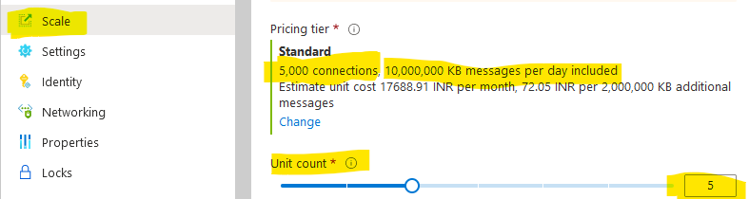
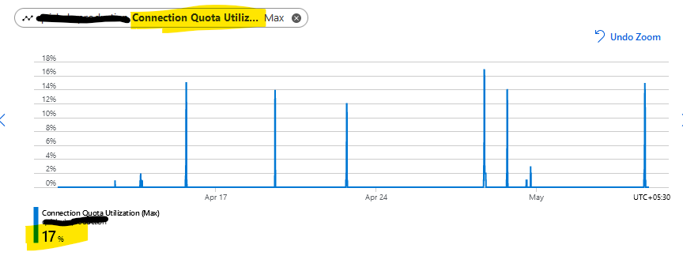
Simple pricing model for scale units / connections.
Unfortunately:
Auto-scale is unavailable (manual scale only).
Reserved capacity only (no pay-as-you-go / consumption plan).
Keep an eye on connection quota used.
Confusing pricing model for in/out messages!!!
Still on my plate:
Optimizing group sizes, message sizes, message frequency, outbound traffic volumes!
Figuring out throttling / rate-limits!

Slide 48
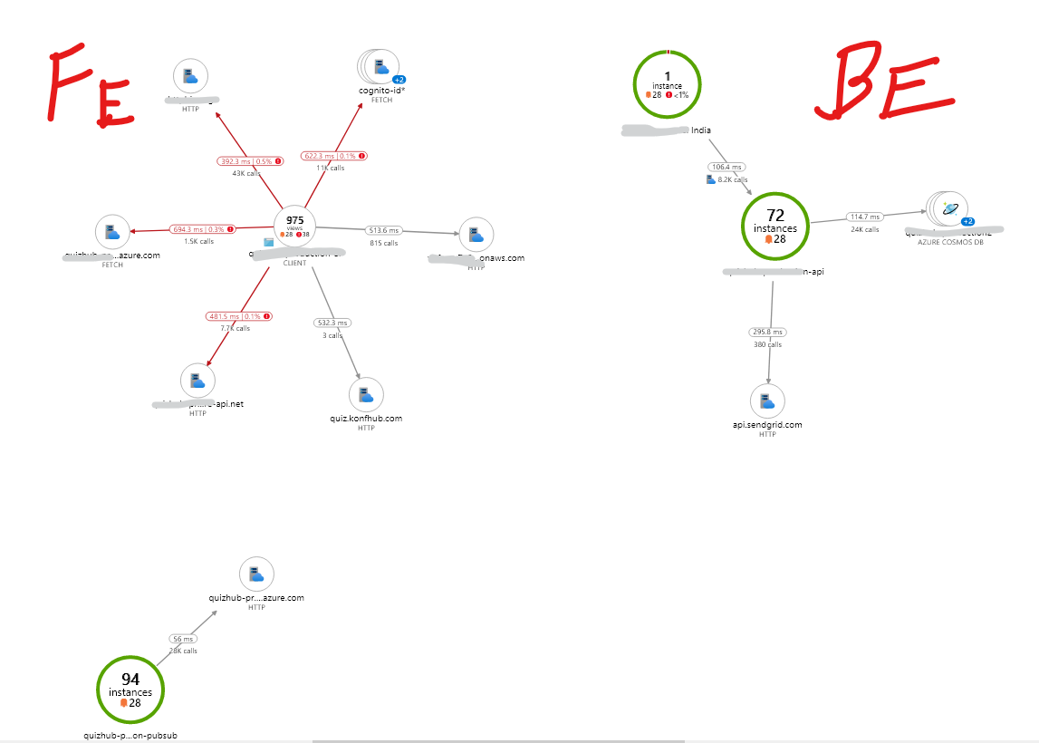
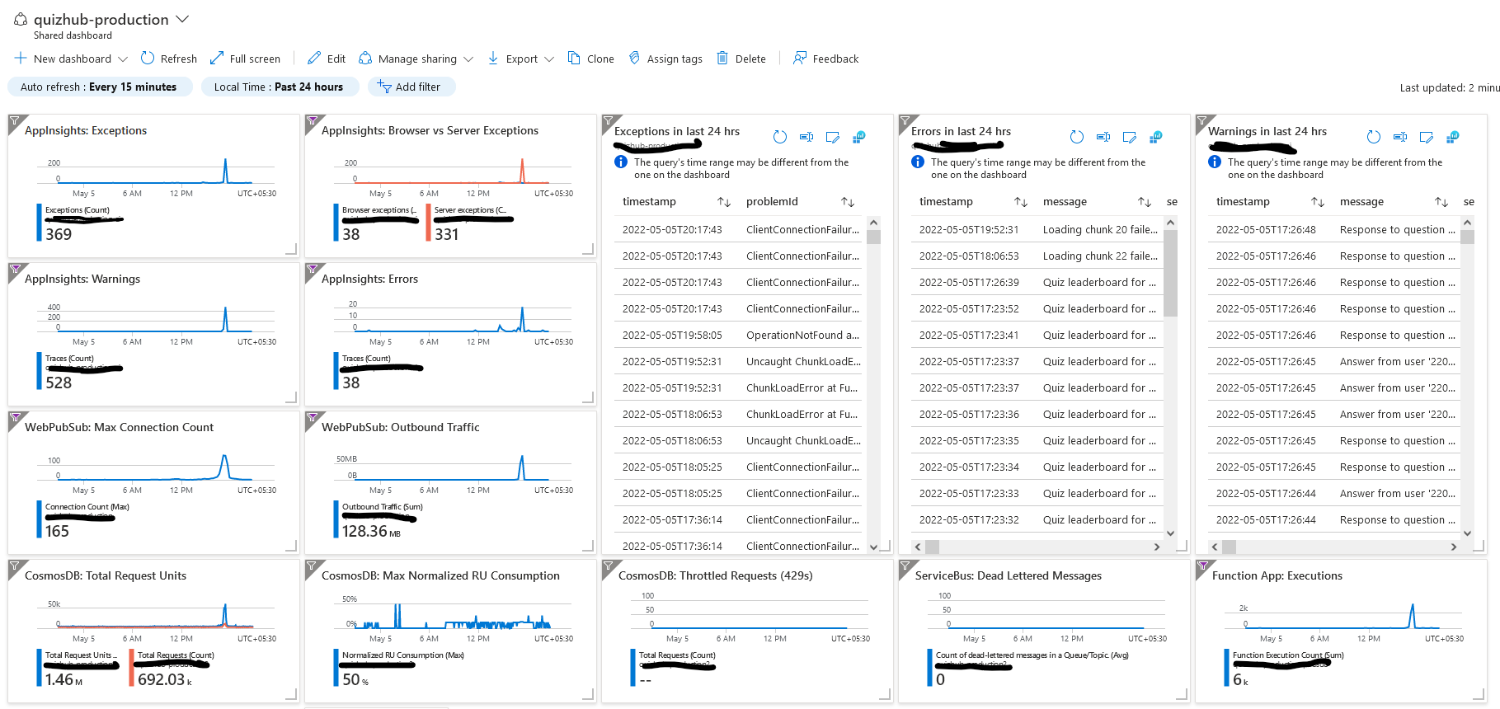

Slide 49
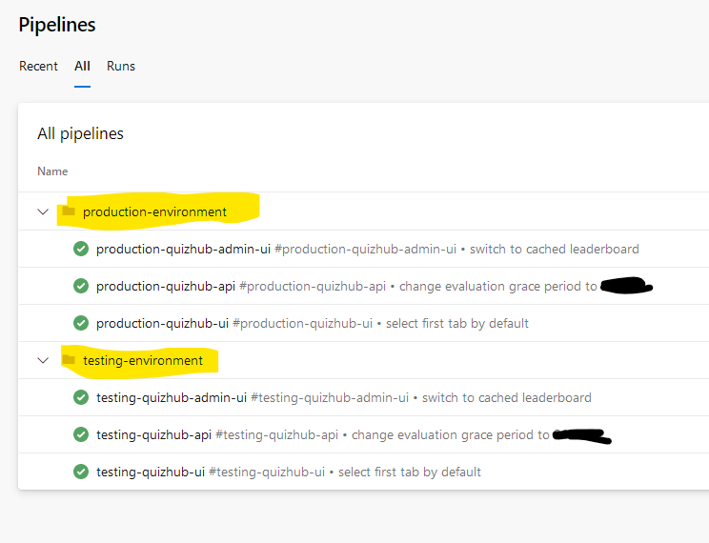

Slide 51
mithun@cloudskew.com

Slide 52
Questions?

Slide 53






Platinum Partner
Gold Partner
Silver Partner

